Slide 1
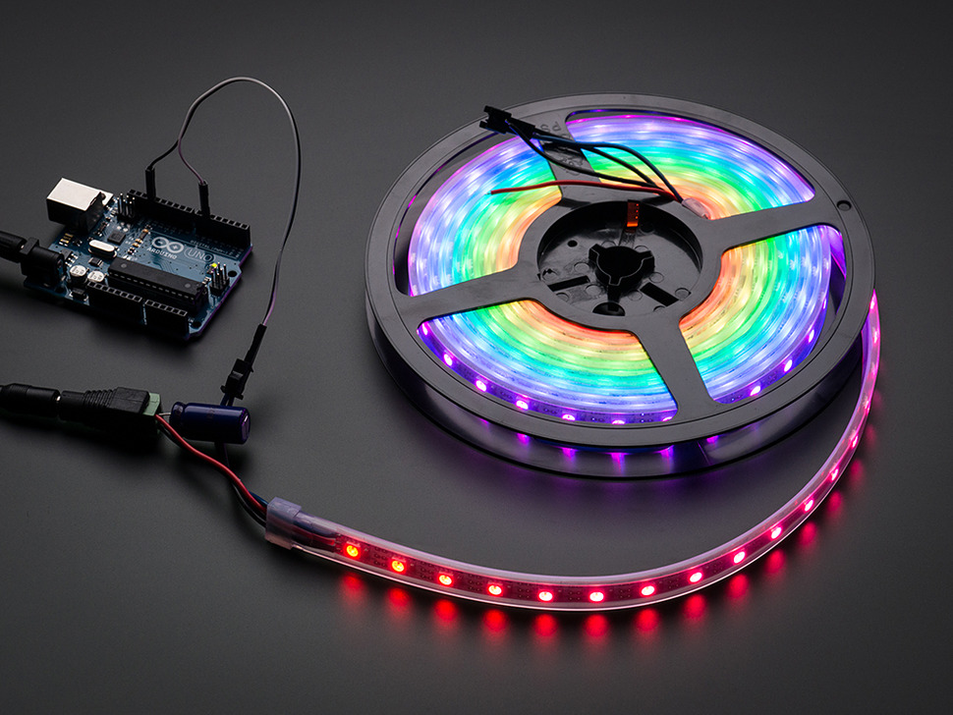
Intro to Lighting
With Arduino

Slide 2
WIFI password 7787857982 Slides and Example source code https://github.com/funvill/ArduinoLightingWorkshop/
Bathrooms Take key that are attached to hammers, from next to the vending machine (pink for boys, blue for girls). Bathrooms are located out the door to the left.
Social media Vancouver Hackspace @VHS http://hackspace.ca
Steven Smethurst (Funvill) @Funvill http://abluestar.com

Slide 3
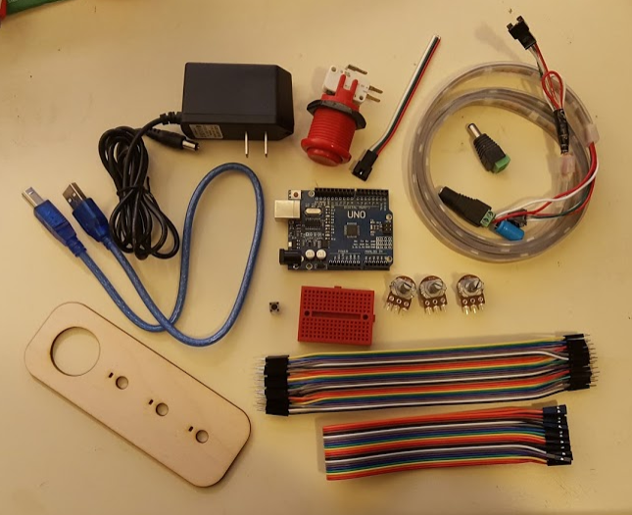
What you should have in your kit
Arduino Uno
RGB LEDs 1 meter strip of Neopixel (WS2812)
Female barrel jack with screw terminal
Male barrel jack with screw terminal
1000uf capacitor
Female jumper wires
3x Potentiometers
Arcade button
LED connector male
Wooden plate for buttons and potentiometers
Breadboard
Male jumper wires
USB-B cable
5V power supply

Slide 4
What is an Arduino?
Open source microcontroller
Many hardware configurations to choose from
Great for prototyping

Slide 5
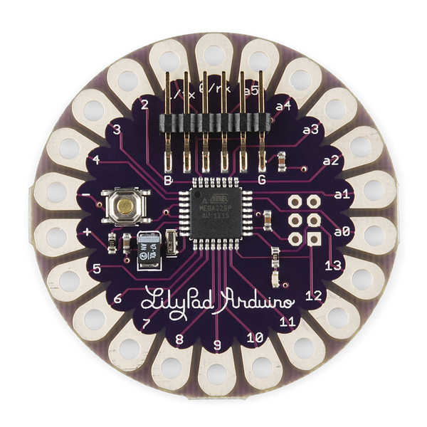
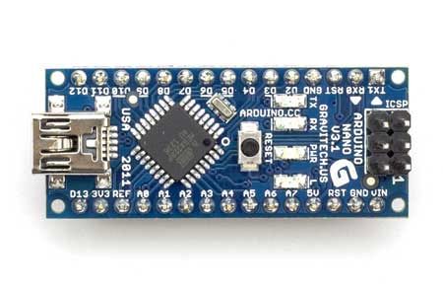
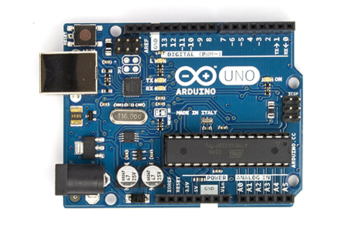
Board Form Factors
LilyPad
Nano
Uno
lilypadarduino.org

Slide 6
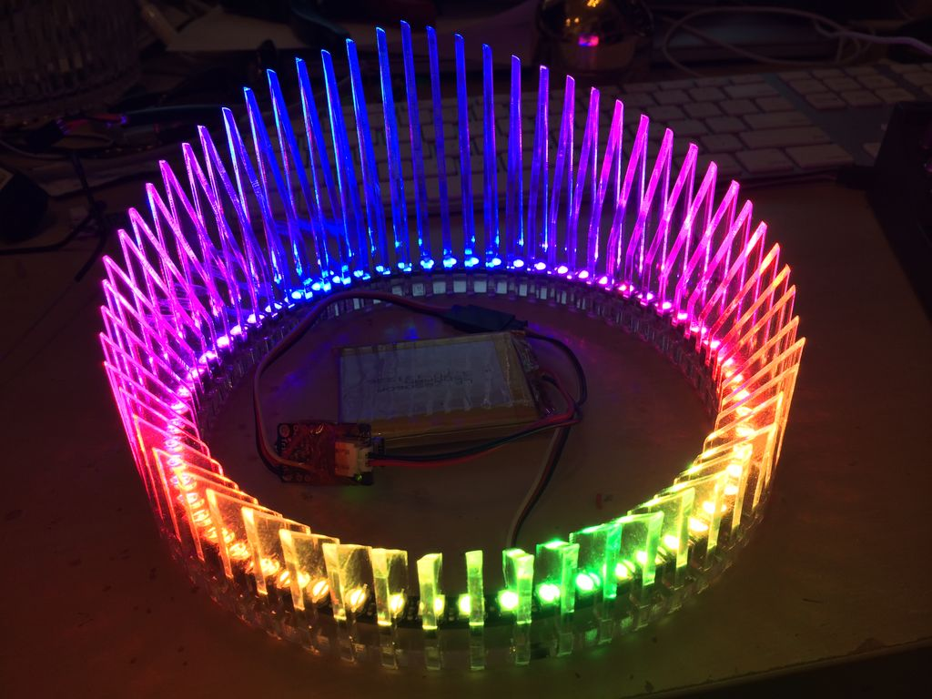
What can I make with an Arduino?
Air Pollution Monitor
Turn Signal Bike Jacket
Tweeting Coffee Pot
Robots
LED “Laser” crown
...and so much more!

Slide 7
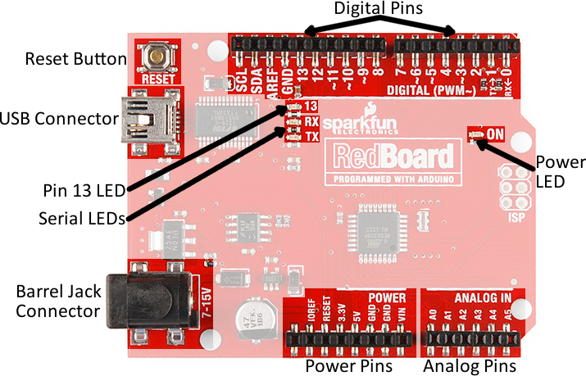
Anatomy of an Arduino
Your arduino might be blue and slightly different.

Slide 8
Setting up for Programming
Install Arduino Editor (http://arduino.cc/)
Plug in your Board to USB
Select your board type Tools ⇒ Board ⇒ Arduino Uno (yours might be different)
Select connection type Tools ⇒ Port ⇒ COM1 (yours might be different)

Slide 9
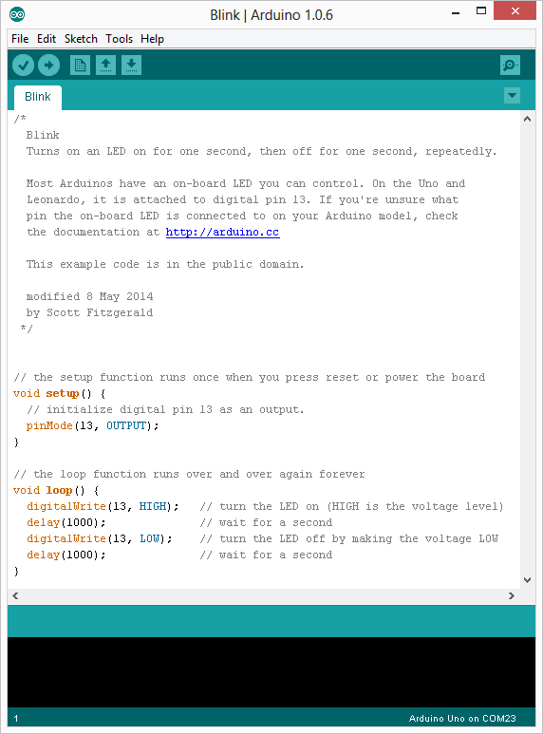
Load the Blink sketch
File ⇒ Examples ⇒ 01.Basics ⇒ Blink
There are many other example sketches that you can load from the example folder.

Slide 10
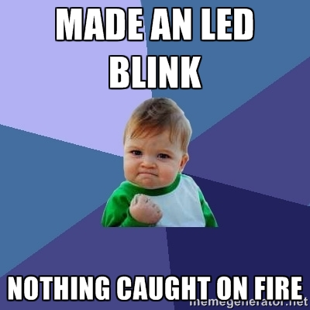
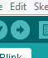
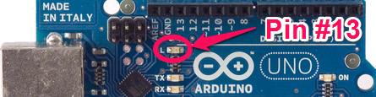
Upload !
Click the upload button to compile and download this sketch to your arduino.
The LED should be blinking!

Slide 11


Slide 12


Slide 13
Blink Sketch
File ⇒ Examples ⇒ 01.Basics ⇒ Blink)
// The setup function runs once when you press reset or power the board void setup() { pinMode(13, OUTPUT); // Initialize digital pin 13 as an output. }
// The loop function runs over and over again forever void loop() { digitalWrite(13, HIGH); // Turn the LED on (HIGH is the voltage level) delay(1000); // Wait for a second digitalWrite(13, LOW); // Turn the LED off by making the voltage LOW delay(1000); // Wait for a second }

Slide 14
Functions
Segmenting code into functions allows a programmer to create modular pieces of code that perform a defined task and then return to the area of code from which the function was "called".
Functions has several advantages:
Stay organized
Functions make the whole sketch smaller and more compact because sections of code are reused many times.
They make it easier to reuse code in other programs by making it more modular, and as a nice side effect, using functions also often makes the code more readable.

Slide 15
Function: digitalWrite()
Write a HIGH or a LOW value to a digital pin. If the pin has been configured as an OUTPUT with pinMode(), its voltage will be set to the corresponding value: 5V for HIGH, 0V (ground) for LOW.
Syntax:
digitalWrite(pin, value)
Parameters:
pin: The pin number value: HIGH or LOW

Slide 16
Function: delay()
Pauses the program for the amount of time (in miliseconds) specified as parameter. (There are 1000 milliseconds in a second.)
1,000 = 1 sec 30,000 = 30 sec 60,000 = 1 min
Syntax:
delay(ms)
Parameters:
ms: the number of milliseconds to pause (unsigned long)

Slide 17
Try this
Change the blink sketch to make the LED blink faster or slower. *Hint:* You can change the value in the delay function.
Change the blink sketch to make a pattern. Do SOS in morse code. Three short blinks, three long blinks, three short blinks

Slide 18
Blink Faster, and Slower
void setup() { pinMode(13, OUTPUT); // Initialize digital // pin 13 as an output. }
// the loop function runs over and over again forever void loop() { digitalWrite(13, HIGH); // Turn the LED on delay(500); // Wait for half second digitalWrite(13, LOW); // Turn the LED off delay(2000); // Wait for two second }

Slide 19
Make your own functions
void setup() { pinMode(13, OUTPUT); // Initialize digital // pin 13 as an output. }
// the loop function runs over and over again forever void loop() { Blink() } void Blink() { digitalWrite(13, HIGH); // Turn the LED on delay(500); // Wait for half second digitalWrite(13, LOW); // Turn the LED off delay(1000); // Wait for one second }

Slide 20
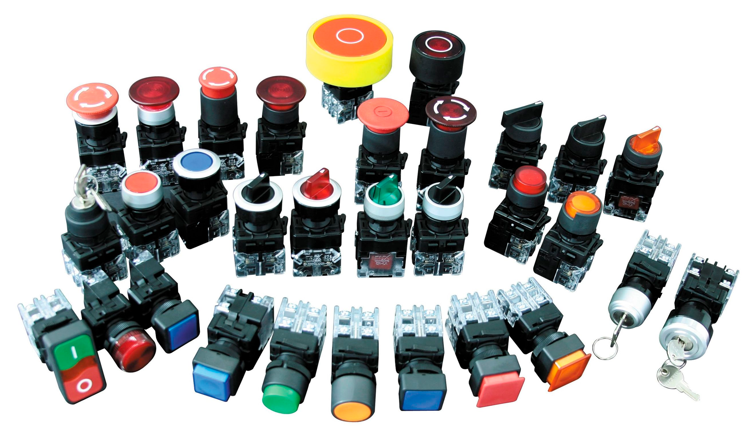
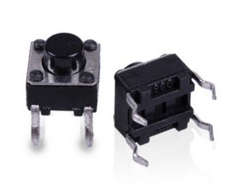
Let’s add a button
Pushbuttons or switches connect two points in a circuit when you press them. This example turns on the built-in LED on pin 13 when you press the button.

Slide 21
Variable Declaration
A variable is a way of naming and storing a value for later use by the program, such as data from a sensor or an intermediate value used in a calculation.
Declaring Variables
Before they are used, all variables have to be declared. Declaring a variable means defining its type, and optionally, setting an initial value (initializing the variable). Variables do not have to be initialized (assigned a value) when they are declared, but it is often useful.
int inputVariable1; int inputVariable2 = 0; // both are correct

Slide 22
Function: DigitalRead()
Reads the value from a specified digital pin, either HIGH or LOW. If the pin isn't connected to anything, digitalRead() can return either HIGH or LOW (and this can change randomly).
int inPin = 7; // pushbutton connected // to digital pin 7 void setup() { // sets the digital pin 7 as input pinMode(inPin, INPUT); } void loop() { // read the input pin int val = digitalRead(inPin); }
Syntax
digitalRead(pin)
Parameters
pin: The number of the digital pin you want to read (int)
Returns
HIGH or LOW

Slide 23
If Statement
The if() statement is the most basic of all programming control structures. It allows you to make something happen or not, depending on whether a given condition is true or not. It looks like this:
if (someCondition) { // do stuff if the condition is true }
There is a common variation called if-else that looks like this:
if (someCondition) { // do stuff if the condition is true } else { // do stuff if the condition is false }

Slide 24
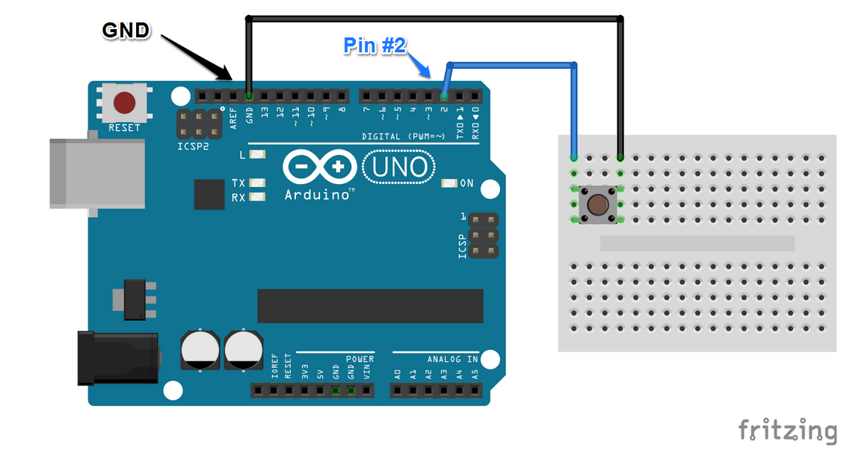
Button Breadboard

Slide 25
Button sketch ( File ⇒ Examples ⇒ 02. Digital ⇒ Button )
// constants won't change. They're used here to set pin numbers: const int buttonPin = 2; // the number of the pushbutton pin const int ledPin = 13; // the number of the LED pin
int buttonState = 0; // variable for reading the pushbutton status void setup() { pinMode(ledPin, OUTPUT); // initialize the LED pin as an output pinMode(buttonPin, INPUT); // initialize the pushbutton pin as an input } void loop() { buttonState = digitalRead(buttonPin); // read the state of the pushbutton value // check if the pushbutton is pressed. if it is, the buttonState is HIGH if (buttonState == HIGH) { digitalWrite(ledPin, HIGH); // turn LED on } else { digitalWrite(ledPin, LOW); // turn LED off } }

Slide 26
Try This:
Make the LED turn off when the button is pressed
Make the LED blink when the button is pressed.
Make the LED blink. Then when the button is pressed make it blink slower or faster.

Slide 27
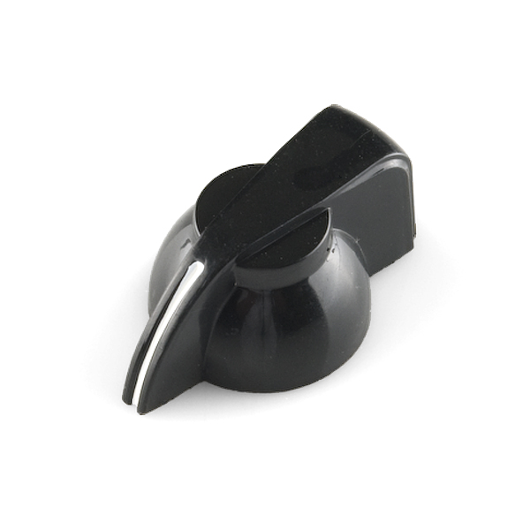

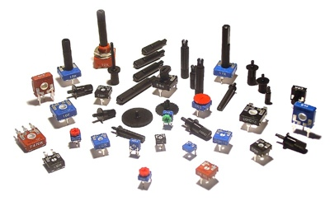
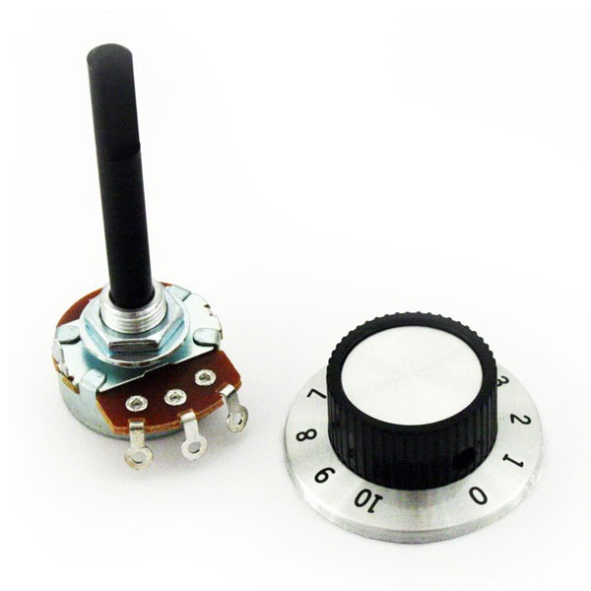
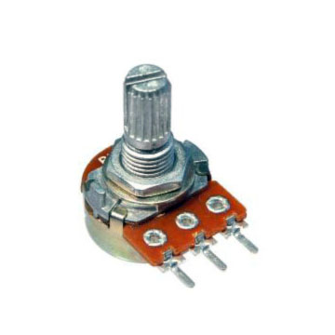
Let’s add a knob (Potentiometer)
A potentiometer is a simple knob that provides a variable resistance, which we can read into the Arduino board as an analog value. In this example, that value controls the rate at which an LED blinks.

Slide 28
Function: AnalogRead()
Reads the value from the specified analog pin. The Arduino board contains a 6 channel, 10-bit analog to digital converter. This means that it will map input voltages between 0 and 5 volts into integer values between 0 and 1023.
analogRead(analogPin);
Syntax
analogRead(pin)
Parameters
pin: The number of the analog input pin to read from 0 to 5 on most boards.

Slide 29
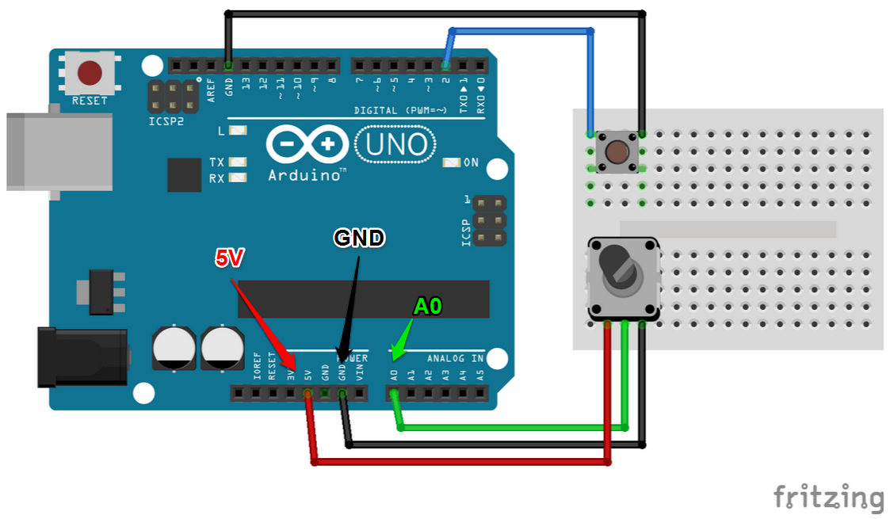
Potentiometer Breadboard

Slide 30
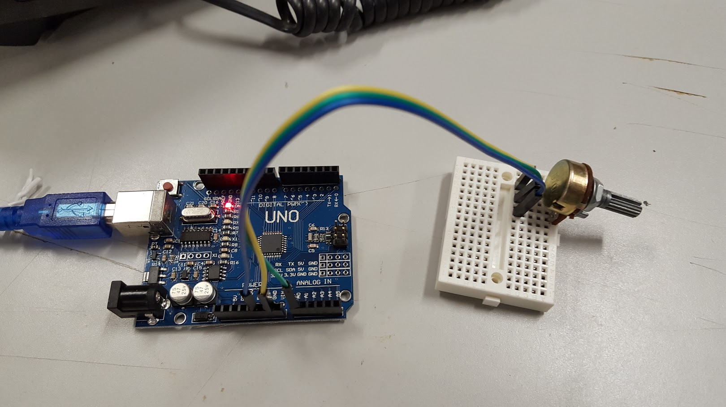

Slide 31
Knob sketch File ⇒ Examples ⇒ 03.Analog ⇒ analogInput
#define POT_PIN 0 // Select the input pin for the potentiometer #define LED_PIN 13 // Select the pin for the LED
int val = 0; // variable to store the value coming from the sensor
void setup() { pinMode(LED_PIN, OUTPUT); // declare the ledPin as an OUTPUT }
void loop() { val = analogRead(POT_PIN); // read the value from the sensor digitalWrite(LED_PIN, HIGH); // turn the ledPin on delay(val); // stop the program for some time digitalWrite(LED_PIN, LOW); // turn the ledPin off delay(val); // stop the program for some time }

Slide 32
Function: Map
Re-maps a number from one range to another. That is, a value of fromLow would get mapped to toLow, a value of fromHigh to toHigh, values in-between to values in-between, etc.
output = map(value,0,1024,0,255); output = map(value,0,1024,0,100);
Syntax: map( value, fromLow, fromHigh, toLow, toHigh )
Parameters: value: The number to map. fromLow: The lower bound of the value's current range. fromHigh: The upper bound of the value's current range. toLow: The lower bound of the value's target range. toHigh: The upper bound of the value's target range.

Slide 33
Knob changes blink speed
// Source: /ArduinoLightingWorkshop/blob/master/arduino/KnobBlink/KnobBlink.ino #define POT_PIN 0 // Select the input pin for the potentiometer #define LED_PIN 13 // Select the pin for the LED
void setup() { pinMode(LED_PIN, OUTPUT); // Declare the ledPin as an OUTPUT }
void loop() { int sensorValue = analogRead(POT_PIN); // Read the value from the sensor int val = map(sensorValue, 0, 1024, 100, 1000); // Change sensorValue to a number between // 100-1000 (0.1 and 1 seconds) digitalWrite(LED_PIN, HIGH); // Turn the ledPin on delay(val); // Stop the program for some time digitalWrite(LED_PIN, LOW); // Turn the ledPin off delay(val); // Stop the program for some time }

Slide 34
Try this:
Make the LED stop blinking when the knob is all the way to the left (off)
Make the LED blink at three different speeds depending on the position of the knob. *Hint* “map” the knob value from 0-1023 to 3 values, and multiply these values by a constant.

Slide 35
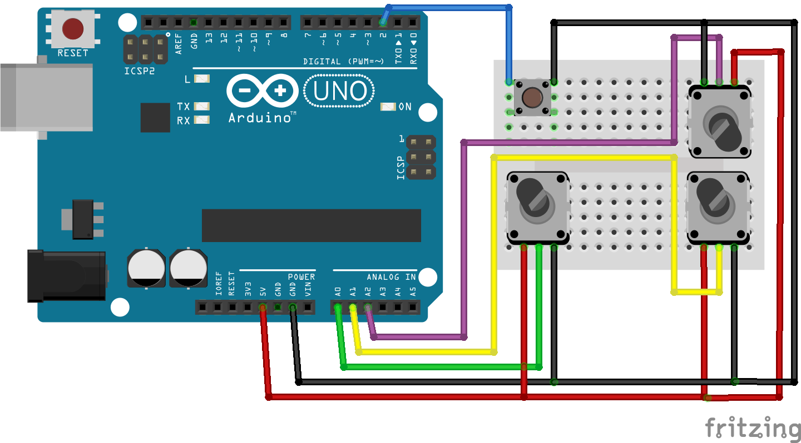
Three from three knobs at once

Slide 36
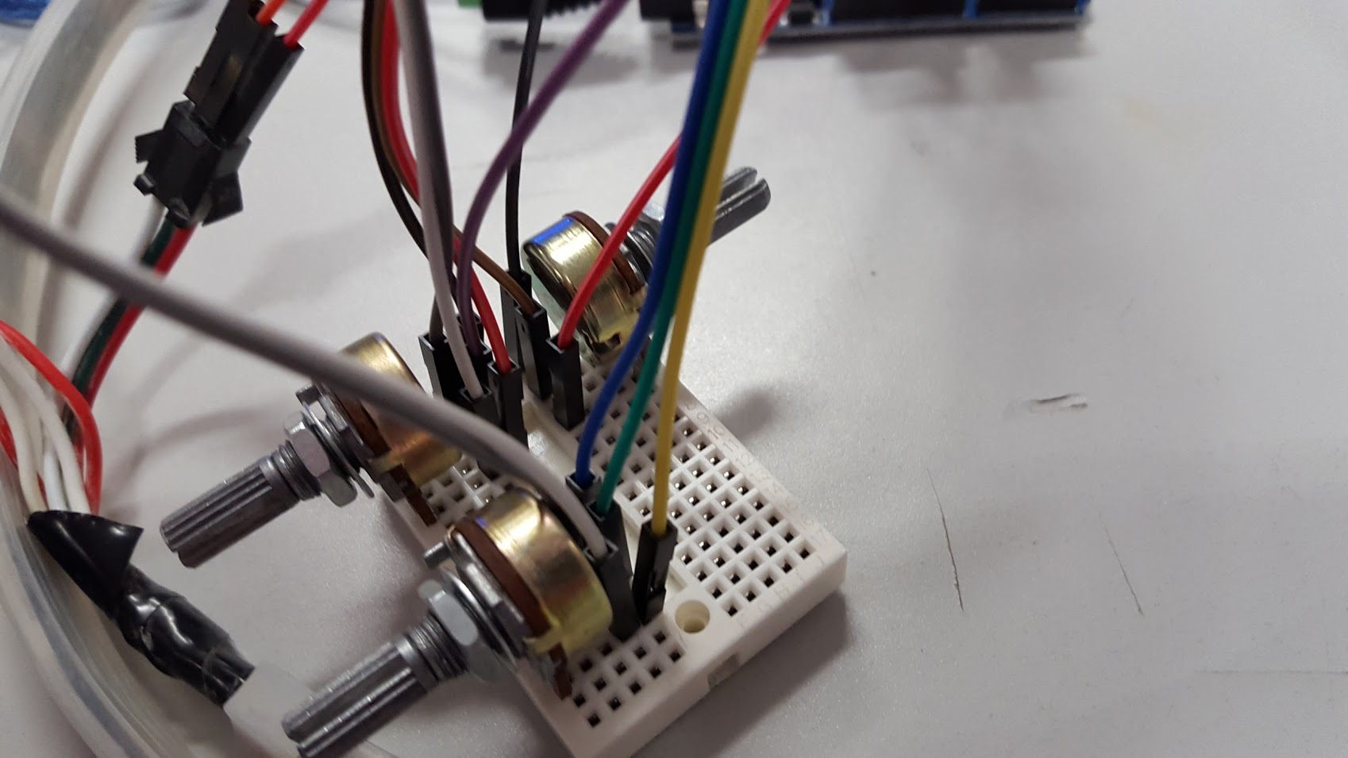

Slide 37
Three knobs at the same time
// Source: /ArduinoLightingWorkshop/tree/master/arduino/ThreeKnobsBlink/ #define LED_PIN 13 // Select the pin for the LED void setup() { pinMode(LED_PIN, OUTPUT); // Declare the ledPin as an OUTPUT }
void loop() { int sensorValueZero = analogRead(0); // Read the value from sensor zero int sensorValueOne = analogRead(1); // Read the value from sensor one int sensorValueTwo = analogRead(2); // Read the value from sensor two int valZero = map(sensorValueZero, 0, 1024, 0, 1000); // Map the value to one second int valOne = map(sensorValueOne, 0, 1024, 0, 1000); // Map the value to one second int valTwo = map(sensorValueTwo, 0, 1024, 0, 1000); // Map the value to one second // Add up all the values from the sensors, use this as a delay for your blinking LED. digitalWrite(LED_PIN, HIGH); // Turn the ledPin on delay(valZero + valOne + valTwo ); // Stop the program for some time digitalWrite(LED_PIN, LOW); // Turn the ledPin off delay(valZero + valOne + valTwo ); // Stop the program for some time }

Slide 38

Let’s Add the LED strip

Slide 39
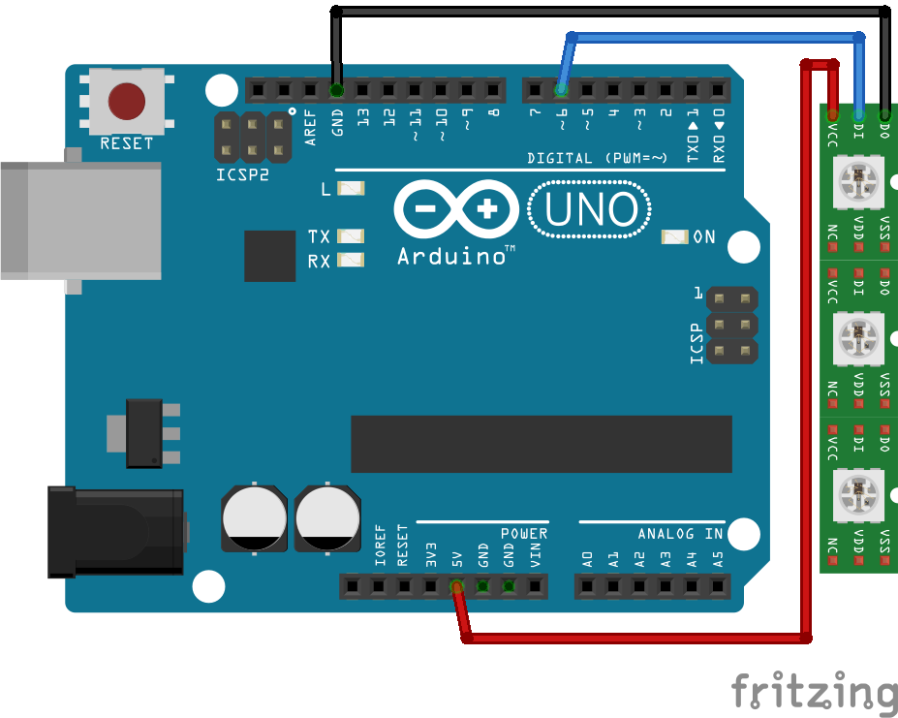
Breadboard NeoPixel LEDs
Arduino LED Strip
GND => GND
PIN D6 => DO
+5V => +5V

Slide 40
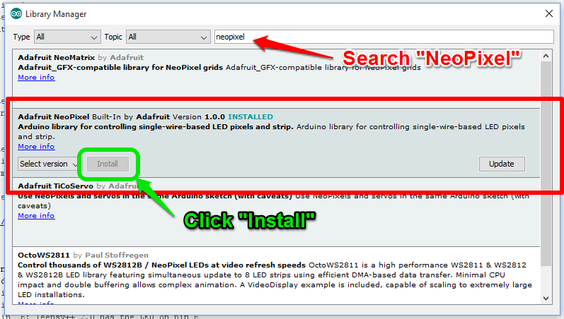
Adding NeoPixel library to Arduino
Sketch => Include Libraries => Manage Libraries

Slide 41
Test the NeoPixel LEDs
File => Examples => Adafruit Neopixel => Strantest

Slide 42

What went wrong?
Either the lights were really dark or they stopped animating.
Your arduino can’t supply enough current to the LEDs for full brightness. When the LEDs require more power than the Arduino can supply it “browns out”.
We need to power the LEDs with the adapter.

Slide 43
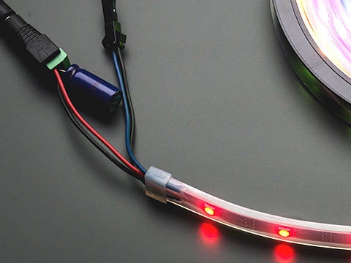
Adding a capacitor to the LED strip
Connect the capacitor (1000 µF, 6.3V or higher) between the positive and negative terminals so of the LED power connector. The capacitor is polarized ensure that you connect it the right way.
Good practice
If powering the pixels with a separate supply, apply power to the pixels before applying power to the microcontroller.

Slide 44
Estimating Power Requirements
Each individual NeoPixel draws up to 60 milliamps at maximum brightness white (red + green + blue). In actual use though, it’s rare for all pixels to be turned on that way. When mixing colors and displaying animations, the current draw will be much less. It’s impossible to estimate a single number for all circumstances, but we’ve been using 1/3 this (20 mA per pixel) as a gross rule of thumb with no ill effects. To estimate power supply needs, multiply the number of pixels by 20, then divide the result by 1,000
30 LEDs * (20 mA) / 1000 = 0.6 Amp // Probably okay 30 LEDs * (60 mA) / 1000 = 1.8 Amp // Guaranteed to work

Slide 45
Voltage drops across long LED strips
The longer a wire is, the more resistance it has. The more resistance, the more voltage drops along its length. If voltage drops too far, the color of NeoPixels can be affected. Consider a full 4 meter reel of NeoPixels. With 5V applied at one end of the strip, for those pixels closest to this end, power traverses only a few inches of copper. But at the far end of the strip, power traverses 8 meters of copper — 4 meters out on the +5V line, 4 meters back on the ground line. Those furthest pixels will be tinted brown due to the voltage drop (blue and green LEDs require higher voltage than red).

Slide 46
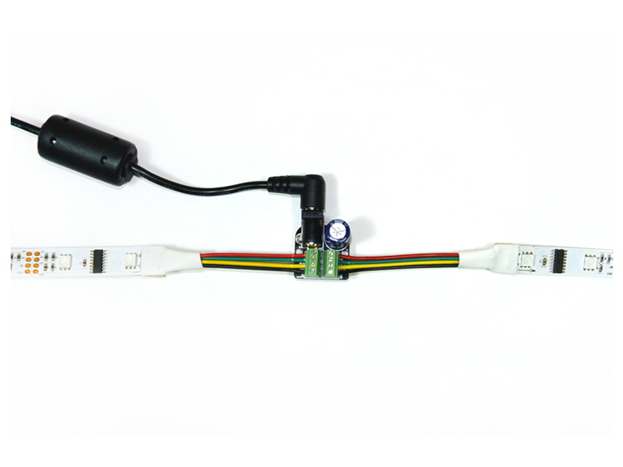
Power taps for long series of LEDs
The way to resolve this is to separate the LEDs power connections into smaller sections. 1 meter or 30 LEDs work best but you can use upto 3 meters and 90 LEDs without too much effect.
http://www.seeedstudio.com/depot/AllPixel-Power-Tap-Kit-p-2380.html

Slide 47
Try the strantest neopixel example again

Slide 48


Slide 49
Function: strip.setPixelColor(n, red, green, blue)
Parameters:
n: Is the pixel number along the strip, starting from 0 closest to the Arduino. If you have a strip of 30 pixels, they’re numbered 0 through 29. It’s a computer thing. red, green, blue: The next three arguments are the pixel color, expressed as red, green and blue brightness levels, where 0 is dimmest (off) and 255 is maximum brightness.

Slide 50
Function: strip.setPixelColor(n, color);
An alternate syntax has just two arguments.
n: Is the pixel number along the strip, starting from 0 color: Is a 32-bit type that merges the red, green and blue values into a single number.
You can also convert separate red, green and blue values into a single 32-bit type for later use:
uint32_t magenta = strip.Color(255, 0, 255);

Slide 51
Function: strip.show();
Function: strip.numPixels()
This updates the whole strip at once, and despite the extra step is actually a good thing. If every call to setPixelColor() had an immediate effect, animation would appear jumpy rather than buttery smooth.
The number of pixels in a previously-declared strip can be queried using strip.numPixels(); If you have defined a value for the number of pixels you can use that instead #define NUMPIXELS 30

Slide 52
Turning on a a single LED
#include <Adafruit_NeoPixel.h> #include <avr/power.h> #define LEDS_PIN 6 #define NUMPIXELS 30 Adafruit_NeoPixel strip = Adafruit_NeoPixel(NUMPIXELS, LEDS_PIN, NEO_GRB + NEO_KHZ800); void setup() { strip.begin(); // This initializes the NeoPixel library. } void loop() { strip.setPixelColor(1, strip.Color(0,150,0)); // Moderately bright green color. strip.show(); // This sends the updated pixel color to the hardware. }

Slide 53
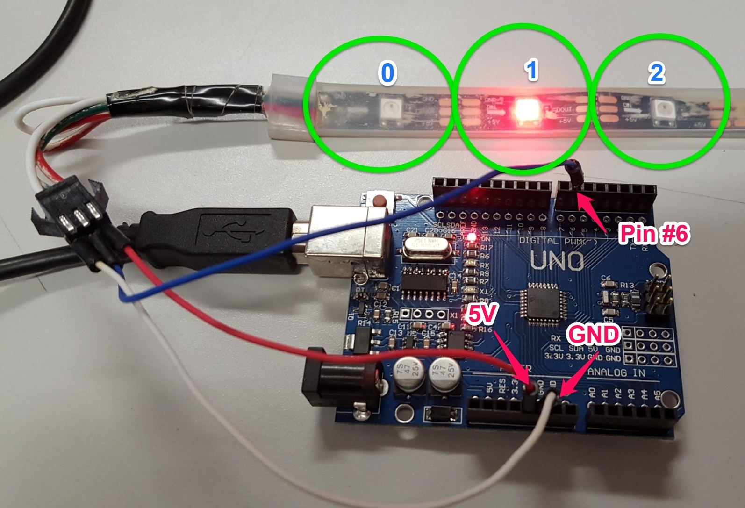

Slide 54
Why did the 2nd LED in the strip turn on?
Programmers count from zero… I know right. Its because binary numbers initial state is all zero and has a value of zero.
strip.setPixelColor(0, strip.Color(0,150,0)); // Will actually turn on the first LED
For example, if there are 30 LEDs your strip you are actually address the LEDs using 0-29

Slide 55
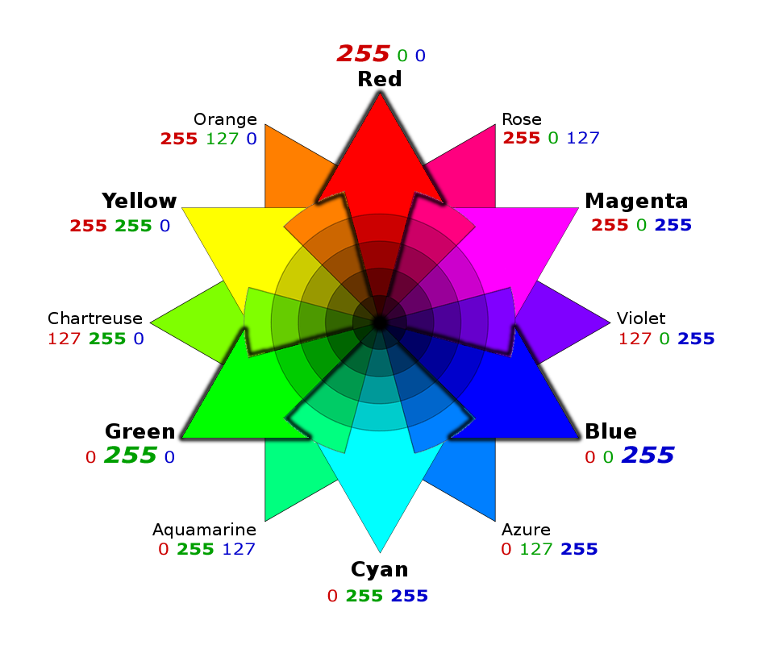
RGB color wheel
The RGB color model is an additive color model in which red, green, and blue light are added together in various ways to reproduce a broad array of colors. The name of the model comes from the initials of the three additive primary colors, red, green, and blue
http://www.colorspire.com

Slide 56
Turning on several LEDs
#include <Adafruit_NeoPixel.h> #include <avr/power.h> #define PIN 6 #define NUMPIXELS 30 Adafruit_NeoPixel strip = Adafruit_NeoPixel(NUMPIXELS, PIN, NEO_GRB + NEO_KHZ800); void setup() { strip.begin(); // This initializes the NeoPixel library. } void loop() { strip.setPixelColor(0, strip.Color(150,0,0)); // Moderately bright red color. strip.setPixelColor(1, strip.Color(0,150,0)); // Moderately bright green color. strip.setPixelColor(2, strip.Color(0,0,150)); // Moderately bright blue color. strip.show(); // This sends the updated pixel color to the hardware. }

Slide 57
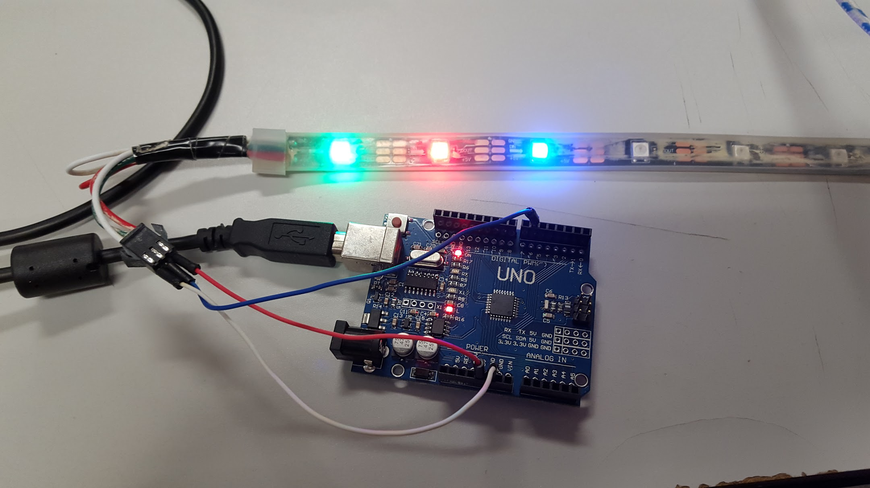

Slide 58
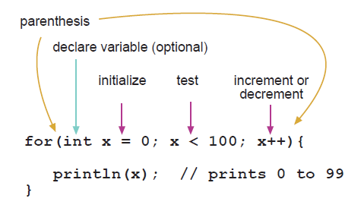
For Statement
The for statement is used to repeat a block of statements enclosed in curly braces. An increment counter is usually used to increment and terminate the loop. The for statement is useful for any repetitive operation, and is often used in combination with arrays to operate on collections of data/pins.
There are three parts to the for loop header:
for (int i=0; i <= 25; i += 5 ) { Serial.print(outputValue); }
Generates: 0, 5, 10, 15, 20, 25

Slide 59
Function: strip.setBrightness(brightness);
setBrightness() sets the max brightness of the LEDs.
setBrightness() was intended to be called once, in setup(), to limit the current/brightness (battery life) of the LEDs throughout the life of the sketch. The operation of this function is “lossy” you will lose the color range.
brightness: The level of brightness 0-255. Lower number is darker
strip.setBrightness(128); // Half brightness

Slide 60
Make all the LEDs Green
#include <Adafruit_NeoPixel.h> #include <avr/power.h> #define LEDS_PIN 6 #define NUMPIXELS 30 Adafruit_NeoPixel strip = Adafruit_NeoPixel(NUMPIXELS, LEDS_PIN, NEO_GRB + NEO_KHZ800); void setup() { strip.begin(); // This initializes the NeoPixel library. strip.setBrightness(128); // Half brightness } void loop() { for( int pixel = 0; pixel < strip.numPixels(); pixel++ ) { strip.setPixelColor(pixel, strip.Color(0,150,0)); // Moderately bright green color. } strip.show(); // This sends the updated pixel color to the hardware. }

Slide 61
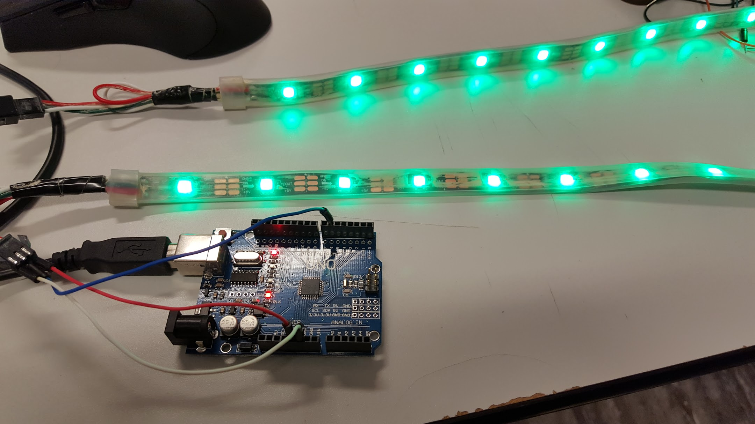

Slide 62
Make a pattern
Repeat the the sequence of red, green, blue across the entire strip of LEDs
void loop() { // Instead of incrementing the for loop by 1, increment by 3 for( int pixel = 0; pixel < strip.numPixels(); pixel +=3 ) { strip.setPixelColor(pixel , strip.Color(150,0,0)); // bright red color. strip.setPixelColor(pixel+1, strip.Color(0,150,0)); // bright green color. strip.setPixelColor(pixel+2, strip.Color(0,0,150)); // bright blue color. } strip.show(); // This sends the updated pixel color to the hardware. }

Slide 63
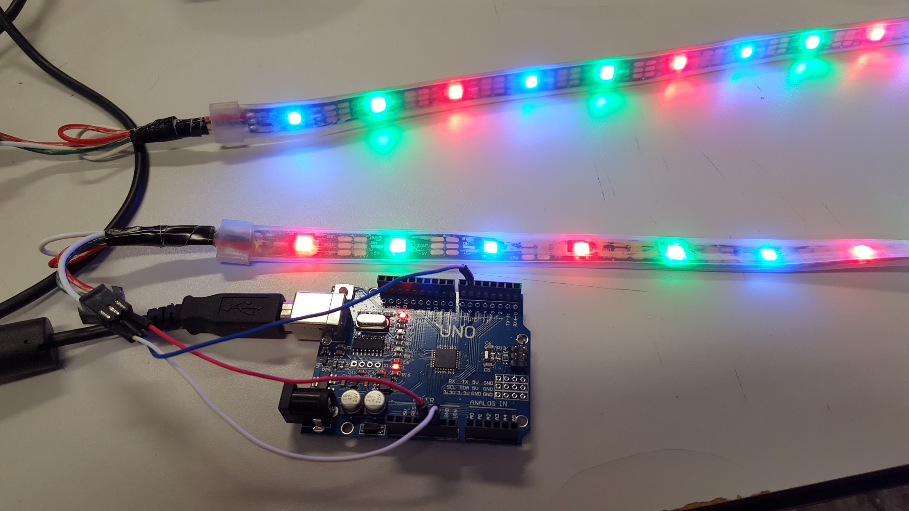

Slide 64
Try this:
Change the pattern to have a sequence of red, red, green, blue, yellow,
Set the entire strip to yellow, then make every 5th LED blue
Create your own patterns.

Slide 65
Putting everything together
Make different patterns and put the patterns in functions. Then use the button to cycle through the different patterns.
Make the knobs change the color of the entire strip. One knob for Red, another knob for blue, another knob for green
Add more patterns

Slide 66
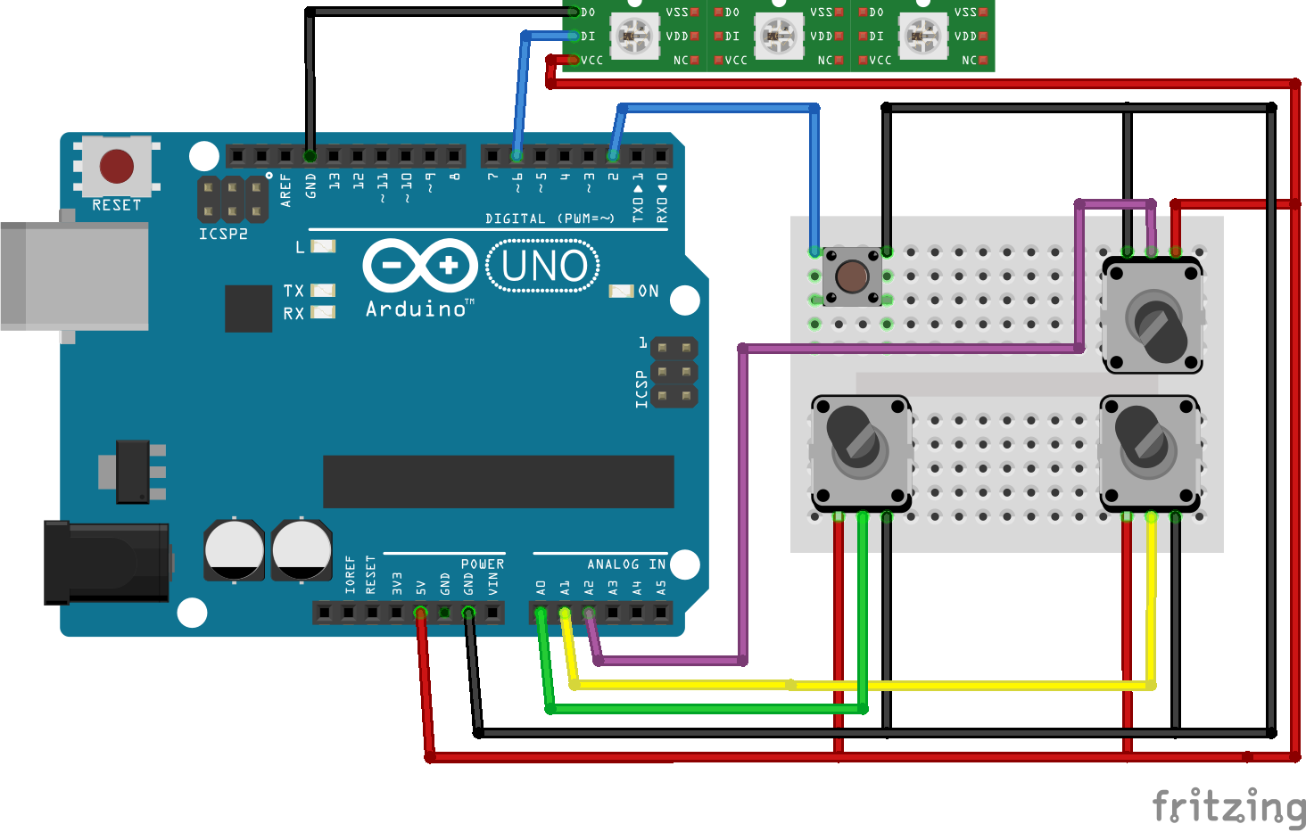

Slide 67
Using a button to cycle through patterns
1/3
#define LED_PIN 13 // the number of the LED pin #define BUTTON_PIN 2 // the number of the pushbutton pin int buttonState; // variable for reading the pushbutton status int pattern ; // variable what pattern we are on. void setup() { pinMode(LED_PIN, OUTPUT); // initialize the LED pin as an output pinMode(BUTTON_PIN, INPUT_PULLUP); // initialize the pushbutton pin as an input pattern = 0; // Set the initial pattern }

Slide 68
Using a button to cycle through patterns
2/3
void loop() { buttonState = digitalRead(BUTTON_PIN); // read the state of the pushbutton value if (buttonState == HIGH) { // If the button has been pressed, pattern++; // Change the pattern. } if( pattern == 1) { BlinkLEDFast(); } else if( pattern == 2) { BlinkLEDSlow(); } else { // If pattern is zero or higher than 3, set pattern = 0 ; // the pattern back to zero. This ensures that BlinkLEDPattern(); // the pattern variable is always 0,1,2 } }

Slide 69
Using a button to cycle through patterns
3/3
// Blink the LED really fast (100ms) void BlinkLEDFast() { digitalWrite(LED_PIN, HIGH); delay(100); digitalWrite(LED_PIN, LOW); delay(100); } // Blink the LED slow (1 second ) void BlinkLEDSlow() { digitalWrite(LED_PIN, HIGH); delay(1000); digitalWrite(LED_PIN, LOW); delay(1000); }
// Blink the LED with a pattern void BlinkLEDPattern() { digitalWrite(LED_PIN, HIGH); delay(1000); digitalWrite(LED_PIN, LOW); delay(100); }

Slide 70
What you have learned so far
IF, For, and Functions statements.
How variables declaration works
How to check to see if a button has been pressed
How to check to see the value of a knob (Potentiometer)
How to do basic bread board wiring
How to install 3rd party libraries into the Arduino IDE
How to change the color and turn on and off LEDs in a Neopixel LED strip
How to make patterns with the Neopixel LED strip
How to switch between patterns with a button.

Slide 71


Slide 72

But wait… There's more.

Slide 73
Changing the LED with the knobs
1/3
#include <Adafruit_NeoPixel.h> #include <avr/power.h> #define LED_PIN 13 #define LEDS_PIN 6 #define NUMPIXELS 30 // the number of LEDs #define BUTTON_PIN 2 // the number of the pushbutton pin int buttonState; // variable for reading the pushbutton status int pattern ; // variable what pattern we are on. Adafruit_NeoPixel strip = Adafruit_NeoPixel(NUMPIXELS, LEDS_PIN, NEO_GRB + NEO_KHZ800); void setup() { strip.begin(); // This initializes the NeoPixel library. pinMode(LED_PIN, OUTPUT); // initialize the LED pin as an output pinMode(BUTTON_PIN, INPUT); // initialize the pushbutton pin as an input pattern = 0; // Set the initial pattern strip.setBrightness(128); // Half brightness }

Slide 74
Changing the LED with the knobs
2/3
void loop() { buttonState = digitalRead(buttonPin); // read the state of the pushbutton value if (buttonState == HIGH) { // If the button has been pressed, pattern++; // Change the pattern. } if( pattern == 1) { BlinkLEDFast(); } else if( pattern == 2) { BlinkLEDSlow(); } else if (pattern == 3) { BlinkLEDPattern(); } else { // If pattern is zero or higher than 4, set pattern = 0 ; // the pattern back to zero. This ensures that ManualControl(); // the pattern variable is always 0,1,2,3 } }

Slide 75
Changing the LED with the knobs
3/3
void ManualControl() { int sensorValueZero = analogRead(0); // Read the value from sensor zero int sensorValueOne = analogRead(1); // Read the value from sensor one int sensorValueTwo = analogRead(2); // Read the value from sensor two int valRed = map(sensorValueZero, 0, 1024, 0, 254); // Map the value to 0-255 int valGreen = map(sensorValueOne, 0, 1024, 0, 254); // Map the value to 0-255 int valBlue = map(sensorValueTwo, 0, 1024, 0, 254); // Map the value to 0-255 for( int pixel = 0; pixel < strip.numPixels(); pixel++ ) { strip.setPixelColor(pixel, strip.Color(valRed,valGreen,valBlue)); } strip.show(); // This sends the updated pixel color to the hardware. }

Slide 77
Bounce with color
1/4
#include <Adafruit_NeoPixel.h> #include <avr/power.h> #define LEDS_PIN 6 #define NUMPIXELS 30 // the number of LEDs #define BUTTON_PIN 2 // the number of the pushbutton pin int buttonState; // variable for reading the pushbutton status int pattern ; // variable what pattern we are on. int cursor ; // location of the cursor Adafruit_NeoPixel strip = Adafruit_NeoPixel(NUMPIXELS, LEDS_PIN, NEO_GRB + NEO_KHZ800); void setup() { strip.begin(); // This initializes the NeoPixel library. pinMode(BUTTON_PIN, INPUT); // initialize the pushbutton pin as an input pattern = 0; // Set the initial pattern cursor = 0 ; strip.setBrightness(128); // Half brightness }

Slide 78
Bounce with color
2/4
void loop() { buttonState = digitalRead(BUTTON_PIN); // read the state of the pushbutton value if (buttonState == HIGH) { // If the button has been pressed, pattern++; // Change the pattern. } if( pattern == 1) { ManualControl(); } else { pattern = 0 ; BounceWithColor(); } }

Slide 79
Bounce with color
3/4
uint32_t Wheel(byte WheelPos) { WheelPos = 255 - WheelPos; if(WheelPos < 85) { return strip.Color(255 - WheelPos * 3, 0, WheelPos * 3); } else if(WheelPos < 170) { WheelPos -= 85; return strip.Color(0, WheelPos * 3, 255 - WheelPos * 3); } else { WheelPos -= 170; return strip.Color(WheelPos * 3, 255 - WheelPos * 3, 0); } }

Slide 80
Bounce with color
4/4
void BounceWithColor() { int valColor = map(analogRead(0), 0, 1024, 0, 254); // Map the value to 0-254 int valSpeed = map(analogRead(1), 0, 1024, 20, 254); // Map the value to 20-254 int valSize = map(analogRead(3), 0, 1024, 2, 10); // Map the value to 2-10 for( int pixel = 0; pixel < strip.numPixels(); pixel++ ) { if( pixel > cursor - valSize/2 && pixel < cursor + valSize/2 ) { strip.setPixelColor(pixel, Wheel( valColor ) ); } } strip.show(); // This sends the updated pixel color to the hardware. cursor++; if( cursor > strip.numPixels() ){ cursor = 0; } delay(valSpeed); }

